Slide 1







Lecture 13:
Controllers & Business Logic
Course - Web Development - III
-By
Pratik Raj Verma
welcome@krmangalam.edu.in
Sohna Road,Gurugram,Haryana 122103

Slide 2

| Table of Contents
Controller
Route Connection
References
The End

Slide 3
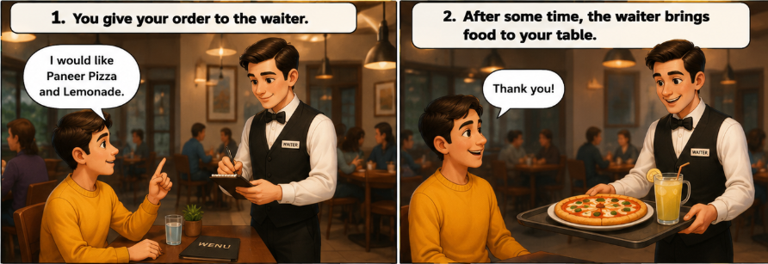
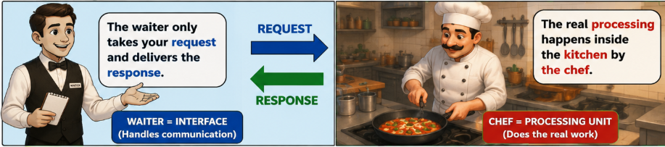
|
Have you ever gone to a restaurant and ordered food? You give your order to the waiter, and after some time, food arrives at your table.
But who actually made the food? Did the waiter cook it, or was someone else working behind the scenes in the kitchen?
No
The waiter only takes your request and sends it to the kitchen.
The waiter does not cook the food and has nothing to do with the kitchen work.
The real work happens inside the kitchen, where the chef prepares the food.

Slide 4
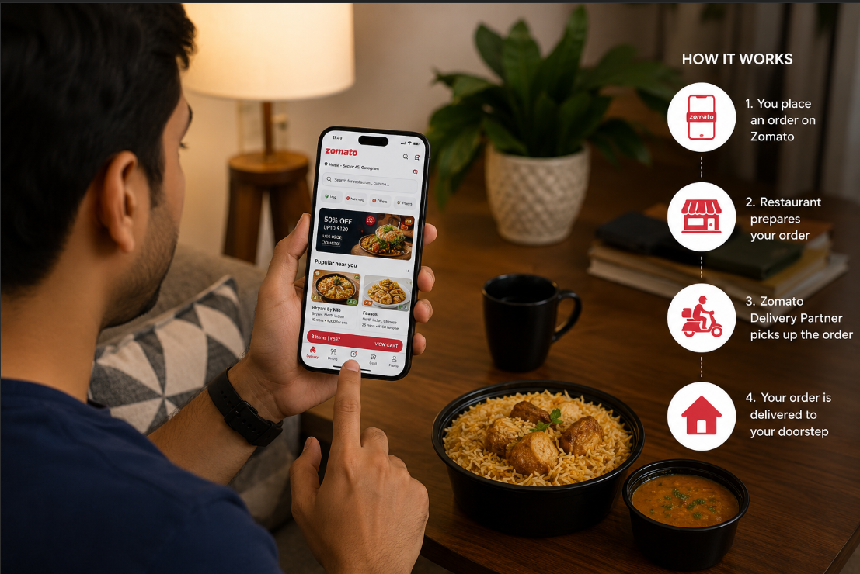
|
Have you ever ordered food online using Zomato or Swiggy?
Come on… today let’s order a burger and understand what Controllers actually do inside backend applications. 😄
Suppose you open Zomato and search for: Burger Near Me
Within a few seconds:
burger images appear
restaurant names are shown
prices and ratings are displayed
Then you click: Order Now
And after some time:
restaurant receives your order
delivery partner gets notification
food starts preparing
order tracking appears on your screen
Now think carefully 🤔
Who searched all nearby restaurants?
Who fetched burger details?
Who created the order?
Who sent request to restaurant?
Who assigned delivery partner?

Slide 5
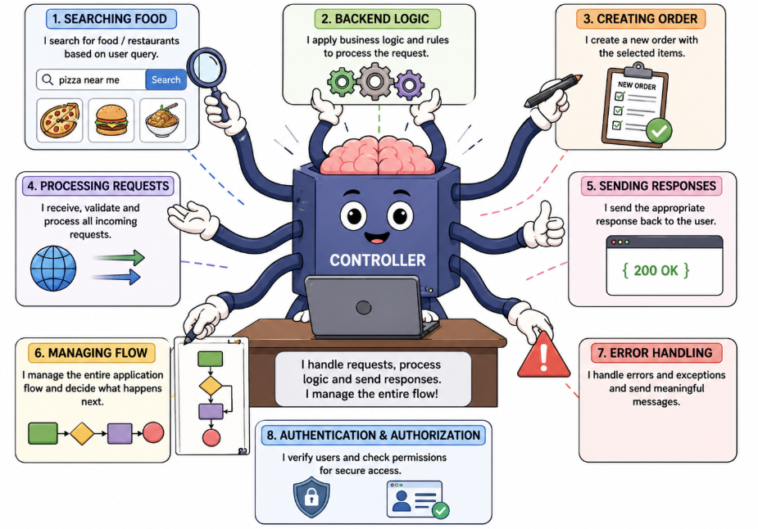
|
Have you ever ordered food online using Zomato or Swiggy?
Come on… today let’s order a burger and understand what Controllers actually do inside backend applications. 😄
Frontend only shows information on screen.
Just like in a restaurant:
waiter only takes your order
waiter sends request to kitchen
The real work happens inside the kitchen.
Similarly in backend:
frontend sends request
routes receive request
But the real processing happens inside: Controllers
That’s why controllers are called:
The Brain of Backend Applications

Slide 6
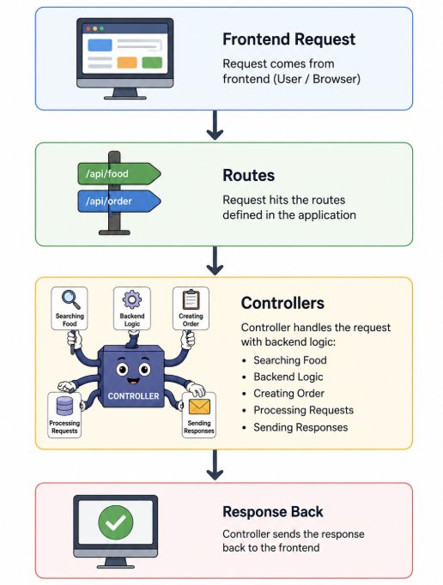
| Controller
A controller is nothing but a JavaScript function. We already learned functions in JavaScript. In the backend, we use those same functions to handle application logic.
Controllers contain the main backend logic and handle requests coming from routes.
Controllers are used to:
Process user requests
Write business logic
Perform CRUD operations with the database
Handle authentication and security
Send responses back to the client

Slide 7
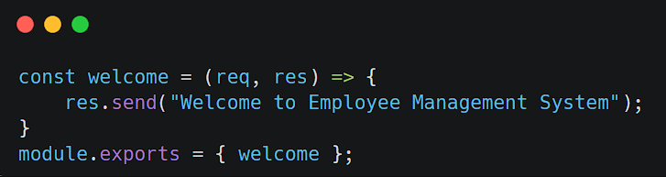
| Controller
Come on! Today we are going to write different controller functions and understand how business logic is created in the backend.
Logic 1 — Send Simple Response
Concept
Controller Function
res.send()
Export Function

Slide 8
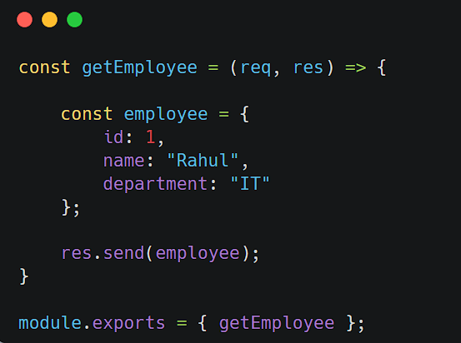
| Controller
Logic 2 — Send Employee Object
Concept
Object Creation
Sending Data to Frontend

Slide 9
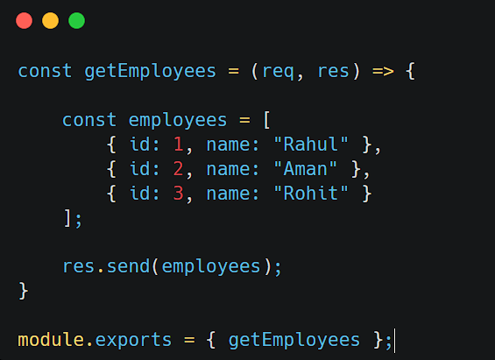
| Controller
Logic 3 — Send Employee Array
Concept
Array
Multiple Records
API Response

Slide 10
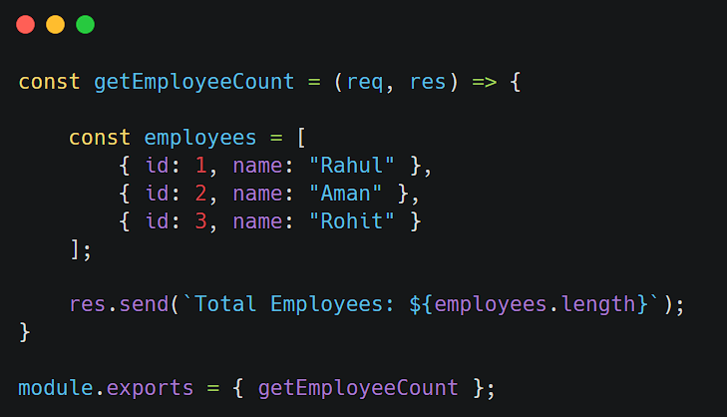
| Controller
Logic 4 — Total Employees Count
Concept
length
Business Statistics

Slide 11
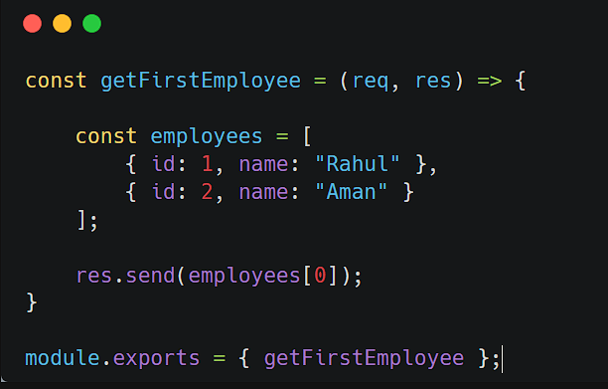
| Controller
Logic 5 — First Employee Details
Concept
Array Indexing

Slide 12
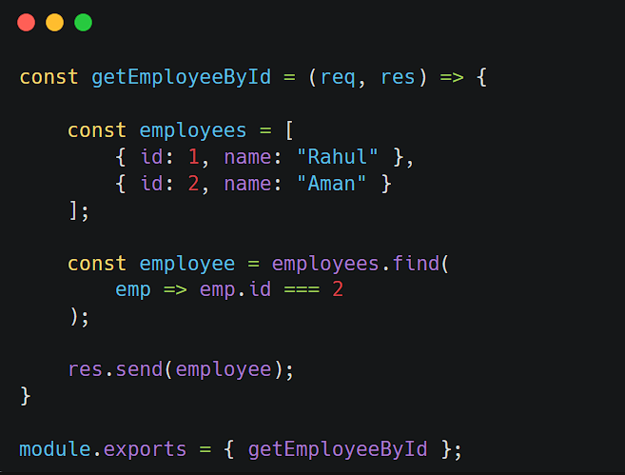
| Controller
Logic 6 — Find Employee by ID
Concept
find()
Searching Data

Slide 13
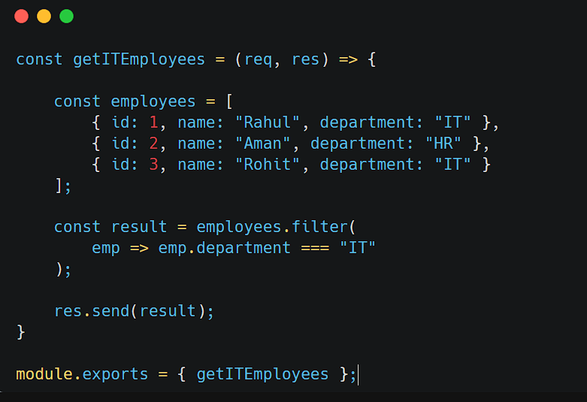
| Controller
Logic 7 — Filter IT Employees
Concept
filter()
Business Filtering

Slide 14
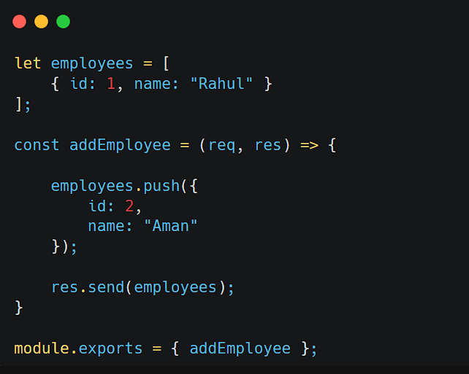
| Controller
Logic 8 — Add New Employee
Concept
push()
Adding Data

Slide 15
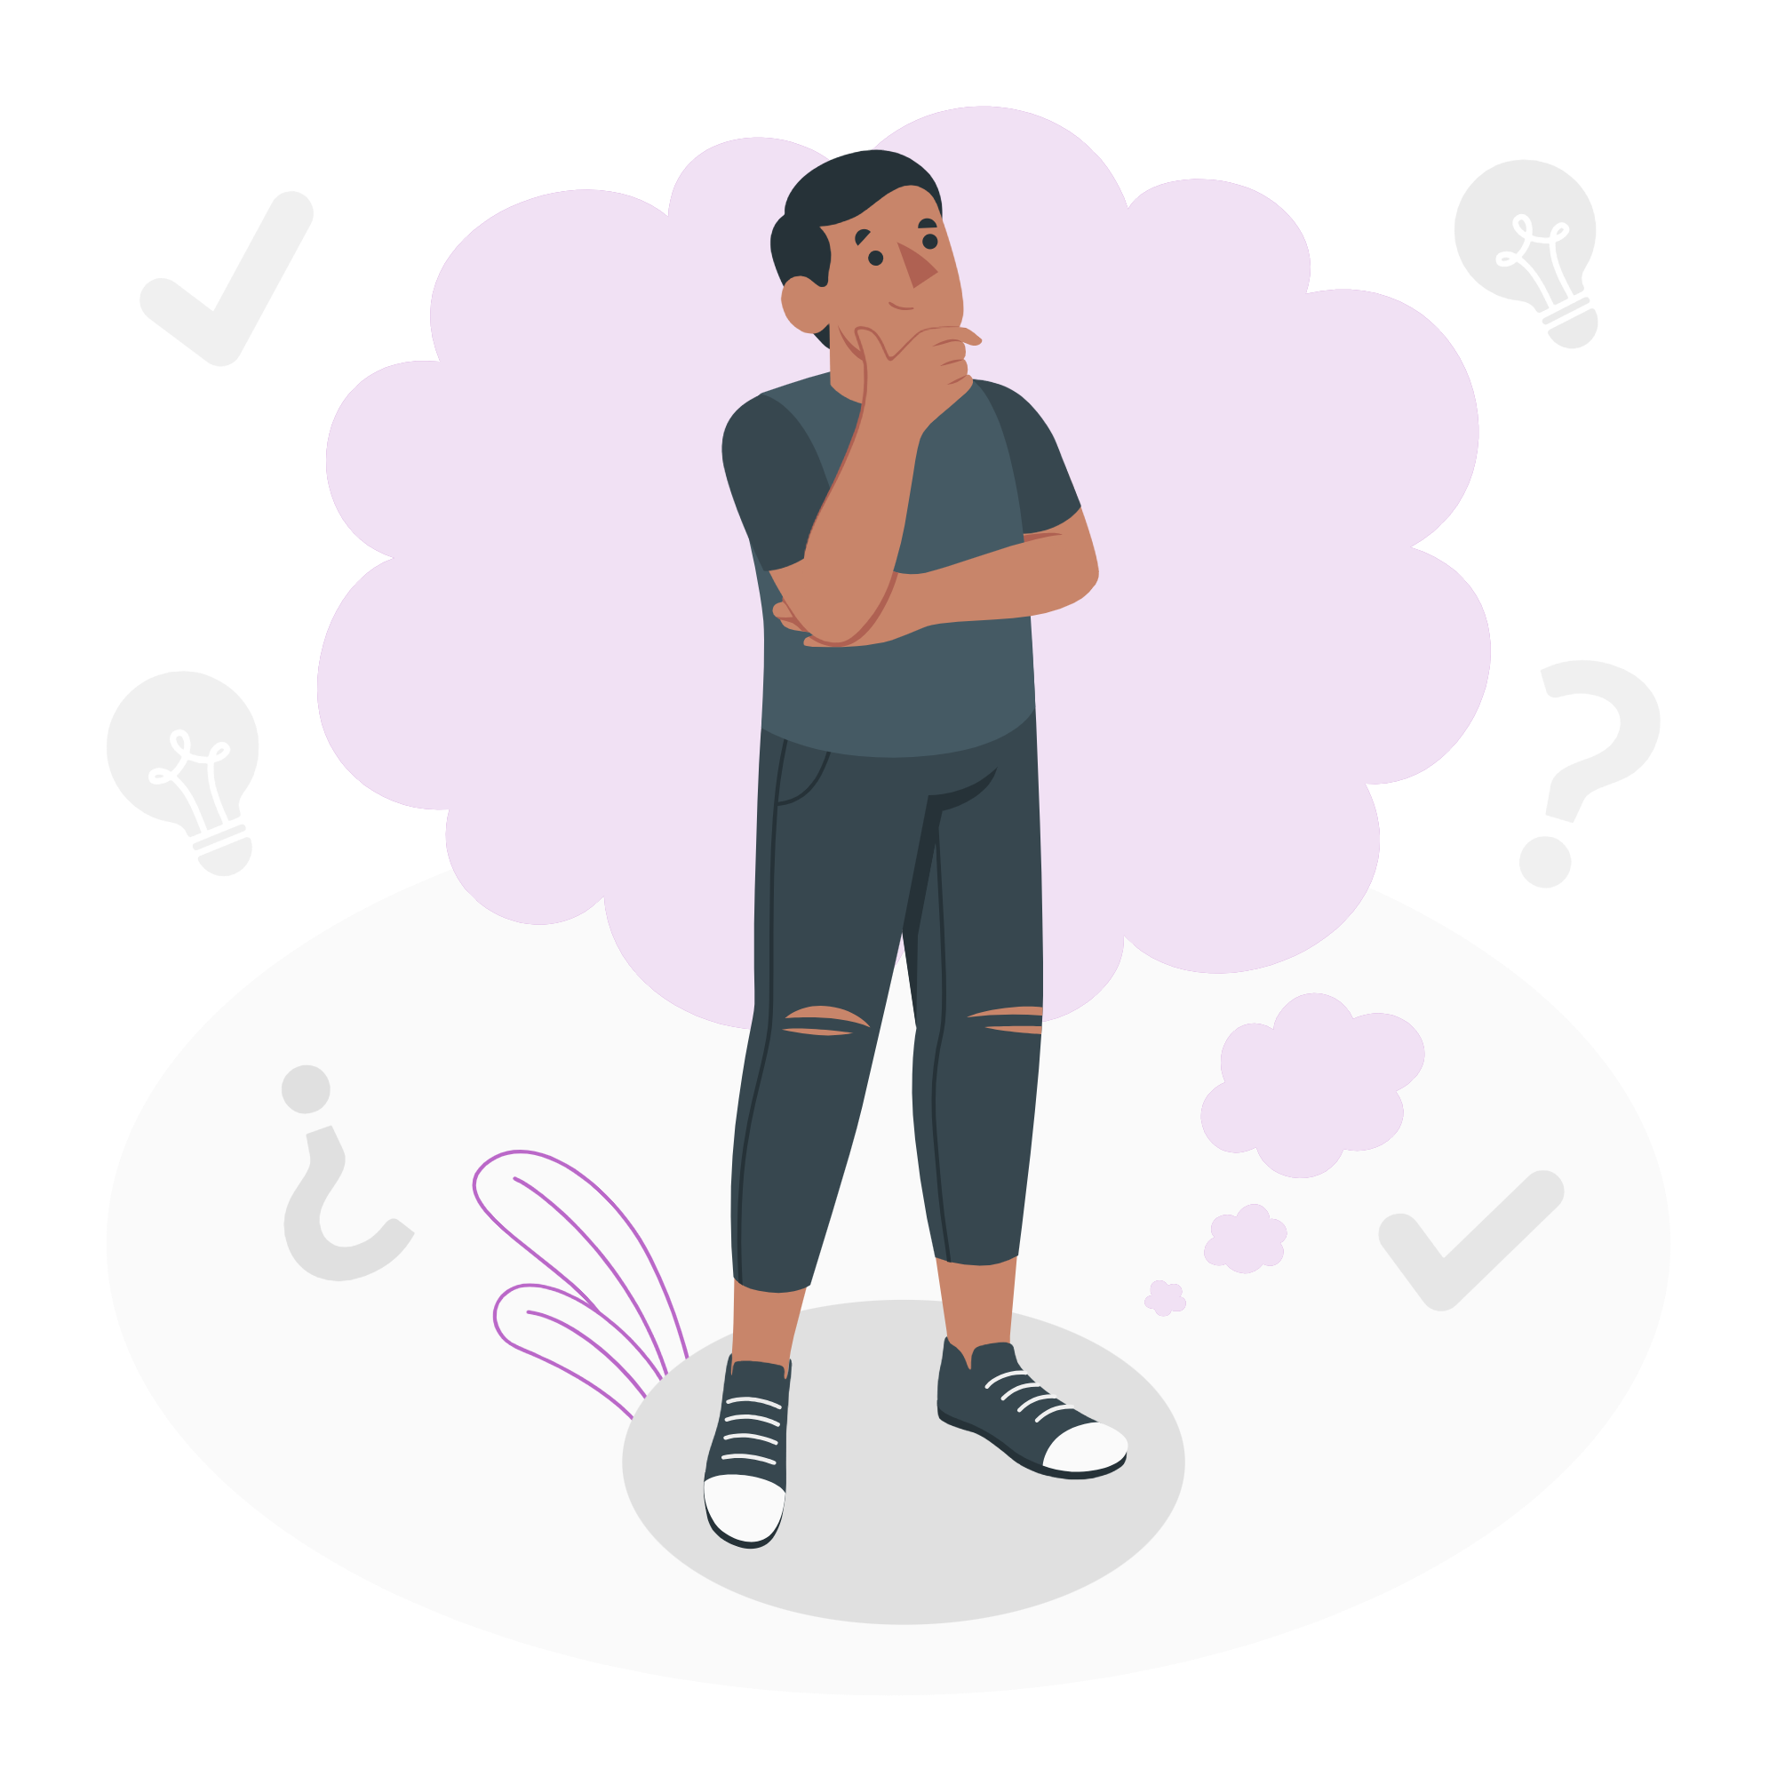
| Okay, we have created the controller function.
But how will this function run? Who will tell Express when to execute this function?

Slide 16
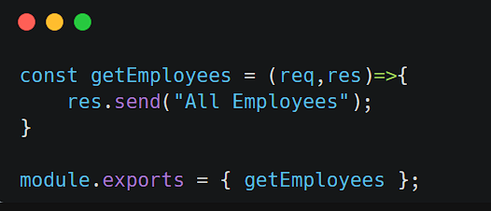
| Route Connection
This function is sitting inside the controller file.
It will not run automatically.
Restaurant Analogy 🍔
Imagine a restaurant.
The chef is ready in the kitchen.
But does the chef start cooking automatically?
❌ No
First:
customer places order
waiter receives order
waiter sends order to chef
Then chef starts cooking.

Slide 17
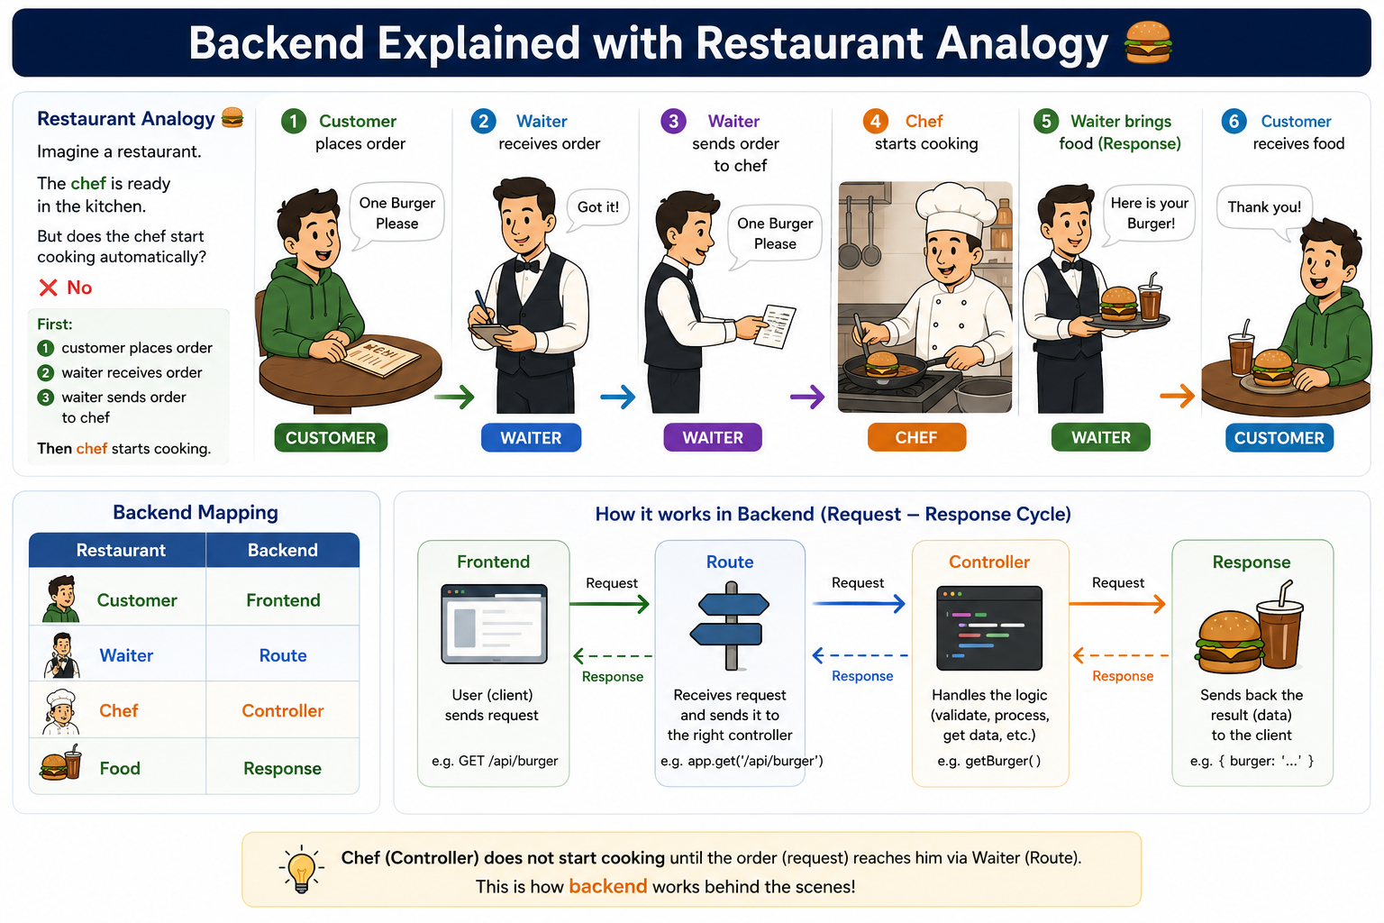
| Route Connection

Slide 18
| Route Connection
What Does Route Do?
Route acts like a bridge between:
When frontend sends request:
GET /employees
Route receives it and says:
Frontend
↓
Route
↓
Controller
“Hey Controller, it's your turn. Execute this function.”

Slide 19
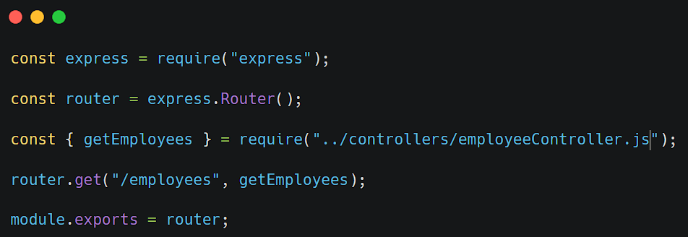
| Route Connection
Route Connection
Routes are responsible for executing controller functions when a request comes from the frontend
Controllers contain the logic, but Routes decide when that logic should run.

Slide 20
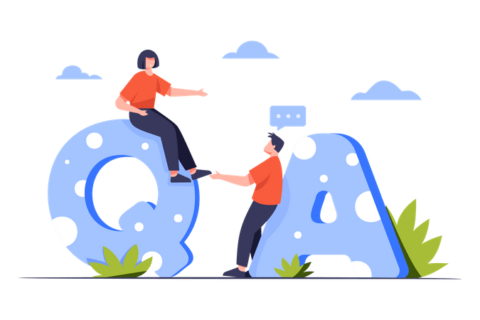
| Check Your Understanding
Question : In MVC Architecture, what is the primary responsibility of a Controller?
Options : A. Store data in database
B. Design frontend UI
C. Handle backend logic and process requests
D. Create project folders
Answer : C. Handle backend logic and process requests
Explanation:
Controllers contain the actual backend logic. They process requests, perform operations, prepare responses, send data back to frontend
That's why Controllers are called the Brain of Backend Applications.

Slide 21
| Check Your Understanding
Question : Suppose a controller function is created, but no route is connected to it. What will happen?
Options : A. Function will run automatically B. Function will run after server starts C. Function will never execute until a route calls it D. Express will throw an error immediately
Answer : C. Function will never execute until a route calls it
Explanation:
Controllers only contain logic.
Routes are responsible for executing controller functions when requests arrive from the frontend.

Slide 22
| Check Your Understanding
Question : Which JavaScript method is commonly used to find a specific employee from an
array?
Options : A. push()
B. filter()
C. find()
D. length()
Answer : C. find()
Explanation:
find() is used to search and return the first matching record.

Slide 23
| References
MDN Web Docs : Comprehensive and official documentation for Express Js 🔗https://developer.mozilla.org/en-US/docs/Learn_web_development/Extensions/Server-side/Express_Nodejs
W3Schools : Beginner-friendly express tutorials with examples and interactive editors. 🔗https://www.w3schools.com/nodejs/nodejs_express.asp
Express Official- A comprehensive tutorial-style website that covers core Express JS concepts in depth.
🔗https://expressjs.com/en/

Slide 24
Thanks
For
Watching
Course - Web Development - III
welcome@krmangalam.edu.in
Sohna Road,Gurugram,Haryana 122103

